Slide 1
Genesis of Austin Flint murmur: mechanism
Dr Shreetal Rajan Nair

Slide 2
The original description
In 1862, AUSTIN FLINT described an apical presystolic murmur in two patients with "considerable" aortic regurgitation who had no evidence of organic mitral stenosis at autopsy.
“In cases of considerable aortic insufficiency the left ventricle is rapidly filled with blood flowing back from the aorta as well as from the auricle, before auricular contraction takes place. The distension of the ventricle is such that the mitral curtains are brought into coaptation and when the auricular contraction takes place, the mitral direct current passing between the curtain throws them into vibration and gives rise to the characteristic blubbering murmur.”
Flint A. On cardiac murmurs. Am J Med Sci 1862;44:29-54.

Slide 3
Genesis of Austin Flint murmur
Mechanisms of genesis of Austin Flint murmur – many controversies exist

Slide 4
Theory of murmur production by Rushmer
Aortic regurgitation could create turbulent flow in the region of the left ventricular inflow tract by
1) altering the pattern and/or rate of mitral valvular flow due to its effect on left ventricular volume or pressure
2) intersecting with the antegrade mitral stream.

Slide 5
Various theories
Functional mitral stenosis :
Abnormal ventricular filling : Austin Flint
impingement of jet on mitral valve: Oshinski et al
impact of a severe regurgitating jet on endomyocardial surface of the left ventricle : Landzberg et al
Fluttering of AML : Rahko et al.
apical radiation of regurgitating jet turbulence: Emi et al
Late diastolic mitral regurgitation

Slide 6
Austin flint murmur : 2 components
Pre systolic
Mid diastolic

Slide 7
Genesis of the presystolic component
increased velocity of antegrade flow across a closing mitral valve
diastolic mitral regurgitation

Slide 8
Timing of the murmur
Mitral valve motion studied in 15 patients with aortic regurgitation and an Austin Flint murmur by recording simultaneously phonocardiogram, apex cardiogram and mitral valve echocardiogram.
13 patients had both presystolic and mid diastolic components; 1 patient only presystolic and 1 patient only mid diastolic
NICHOLAS J. FORTUIN and ERNEST CRAIGE. On the Mechanism of the Austin Flint Murmur. Circulation .1972;45:558-570

Slide 9
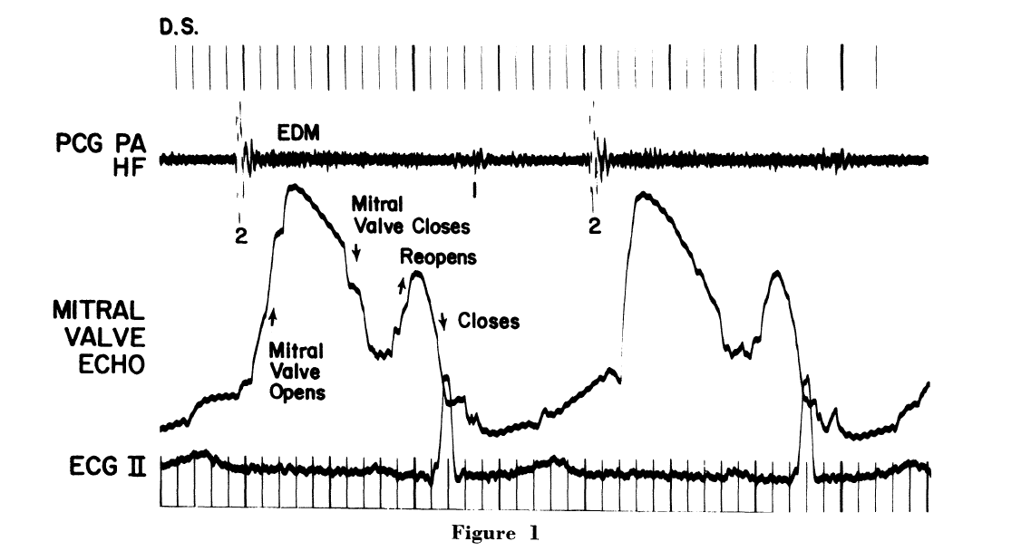
NICHOLAS J. FORTUIN and ERNEST CRAIGE. On the Mechanism of the Austin Flint Murmur. Circulation .1972;45:558-570

Slide 10
th
13 patients : moderate to severe AR
15 controls
They postulated that this murmur is generated by an increase in mitral flow velocity
incomplete left atrial emptying during early diastole
2) excessively rapid closure of the mitral valve due to two sources of left ventricular inflow

Slide 11
Incomplete valve opening rather than excessively rapid closure rate may be the essential requirement for producing increased mitral flow velocity.
closing motion of the mitral valve is not an essential requirement for genesis of the Flint murmur as suggested by the earlier onset of the mid-diastolic component

Slide 12
Conclusions
Production of the murmur requires the presence of a significant amount of aortic insufficiency
The sound causing the murmur, based on the intracavity phonocardiographic observations originates in the inflow portion of the left ventricle.
The murmur is observed only when the mitral valve is open and forward flow is present.

Slide 13
THANK YOU

